Slide 1
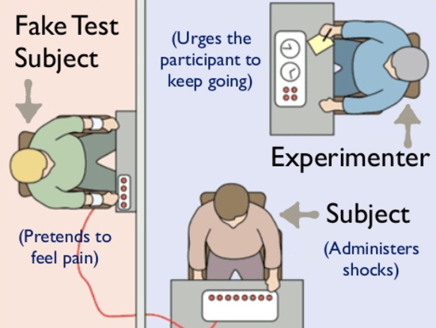
Week 1
revision
grammar → conditional tense zero and type 1
listening comprehension → science and ethics – the milligram experiment

Slide 2
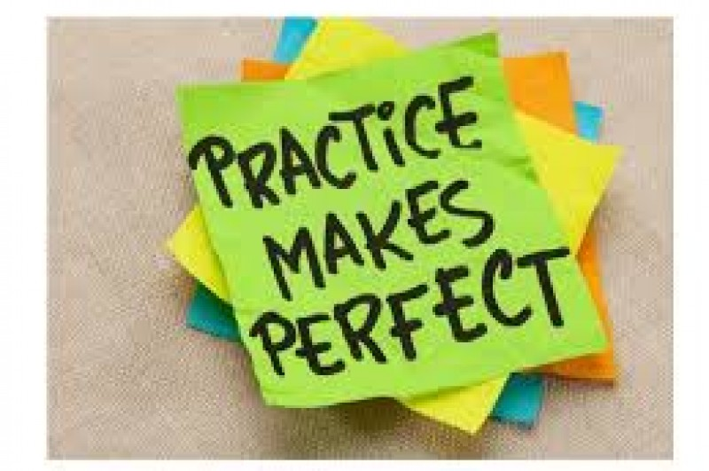
Grammar ☺
Take out your grammar book and we will try some of the exercises as revision form last semester.

Slide 3
Revision – simple past or past continuous
Complétez avec le prétérit simple ou le prétérit Be + V-ing.
An angry mum (demand) ____________________ an inquiry after her three-year-old daughter (be left) ____________________ behind on a school outing. Little Ann Marie (be) ____________________ in tears as she (watch) ____________________ the coach that (carry) ____________________ her 27 school-mates leave without her. When the staff at the zoo (find out) ____________________ Ann Marie one hour after the departure of the coach, the little girl (sit) ____________________ on the ground and still (cry) ____________________. They (try) ____________________ to comfort her by giving her some sweets. But it (take) ____________________ them quite a long time to calm her down. Teachers only (find) ____________________ she (be missing) ____________________ two hours later when they (arrive) ____________________ at the village school 60 miles away.

Slide 4
Answers…
An angry mum demanded an inquiry after her three-year-old daughter was left behind on a school outing. Little Ann Marie was in tears as she watched the coach that carried her 27 school-mates leave without her. When the staff at the zoo found Ann Marie one hour after the departure of the coach, the little girl was sitting on the ground and was still crying. They tried to comfort her by giving her some sweets. But it took them quite a long time to calm her down. Teachers only found out she was missing two hours later when they arrived at the village school 60 miles away.

Slide 5
Revision – simple past or present perfect continuous
Complétez avec le prétérit ou le present perfect Be + V-ing
Five years ago, Alison (be) _________________________ in a group called « Life’s Addiction ». They (get) _________________________ a contract but the group (split up) _________________________ just when they (be) _________________________ on the verge of success. She (sing) _________________________ with a group called ‘Red Snapper’ for two years now. She (sing) _________________________ in clubs since her first album (come) _________________________ out.

Slide 6
Answers…
Five years ago, Alison was in a group called « Life’s Addiction ». They got a contract but the group split up just when they were on the verge of success. She has been singing with a group called ‘Red Snapper’ for two years now. She has been singing in clubs since her first album came out.

Slide 7
Revision – simple past or present perfect
Complétez avec le prétérit ou le present perfect.
Jonathan Powells (be) _________________________ an environmentalist for 25 years now. He (become) _________________________ a prominent activist when he (give up) _________________________ eating meat 15 years ago. Over the last ten years, his anti-meat campaign (contribute) _________________________ to the drop in beef consumption in America. Since he (start) _________________________ campaigning, beef consumption (drop) _________________________ by 5%.
Paul Hutchinson (start) _________________________ his campaign against the slaughter of dolphins many years ago. For five days in October 1991 he (film) _________________________ hundreds of dolphins trapped in fishermen’s nets in the Pacific. Since his film (be) _________________________ released, thousands of people (join) _________________________ in the campaign for the protection of dolphins.

Slide 8
Answers
Jonathan Powells has been an environmentalist for 25 years now. He became a prominent activist when he gave up eating meat 15 years ago. Over the last ten years, his anti-meat campaign has contributed to the drop in beef consumption in America. Since he started campaigning, beef consumption has dropped by 5%.
Paul Hutchinson started his campaign against the slaughter of dolphins many years ago. For five days in October 1991 he filmed hundreds of dolphins trapped in fishermen’s nets in the Pacific. Since his film has been/was released, thousands of people have joined in the campaign for the protection of dolphins.

Slide 9
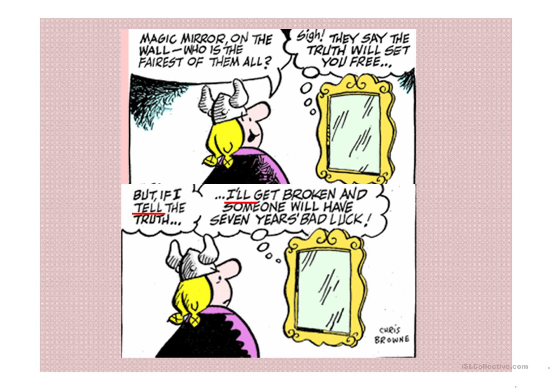
The conditional tense
Conditional tenses are used to speculate about what could happen, what might have happened, and what we wish would happen. In English, most sentences using the conditional contain the word if. Many conditional forms in English are used in sentences that include verbs in one of the past tenses. This usage is referred to as "the unreal past" because we use a past tense but we are not actually referring to something that happened in the past.

Slide 10
the conditional consists of 2 clauses i.e. 2 actions, where one action depends on the other one
e.g. (1) if you forget to turn on the oven, (2) your food will not cook. = your food will not cook only if you forget to turn on the oven, it depends on the action of turning on the oven

Slide 11
The conditional tense…
Conditional sentence type | Usage | If clause verb tense | Main clause verb tense
Zero | General Truths | Simple Present | Simple present
Type 1 | A possible condition and its probable result | Simple present | Simple future
Type 2 | A hypothetical condition and its probable result | Simple past | Present conditional or present continuous conditional
Type 3 | An unreal past condition and its probable result in the past | Past perfect | Perfect conditional
Mixed Type | An unreal past condition and its probable result in the present. | Past perfect | Present conditional

Slide 12
Defintions…
If clause = the condition
Main clause = the result
Today we will focus on the zero conditional and the type 1 conditional

Slide 13
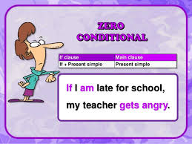
The zero conditional
The zero conditional is used for when the time being referred to is now or always and the situation is real and possible. The zero conditional is often used to refer to general truths. The tense in both parts of the sentence is the simple present. In zero conditional sentences, the word "if" can usually be replaced by the word "when" without changing the meaning.
used to convey fact/truth/principle
the tense is the present simple
sentences can start with when/if

Slide 14
Construction
If clause =
If
+
Simple present
If it rains
If it rains the grass gets wet.
If you heat ice
If you heat ice it melts
Main Clause =
Simple Present
+ the grass gets wet
+ it melts

Slide 15
rule
if / when
+ 2 clauses both in present simple
(1) if you go to a Thai temple, (2) you take off your shoes and cover your head

Slide 16
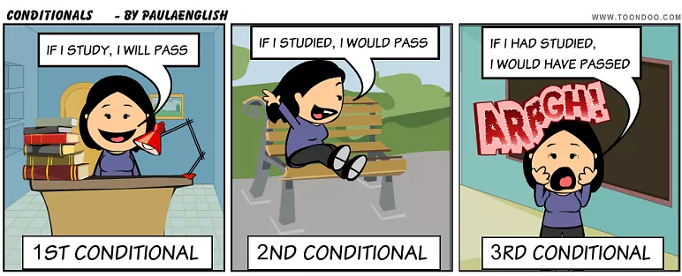
First conditional
The type 1 conditional is used to refer to the present or future where the situation is real. The type 1 conditional refers to a possible condition and its probable result. In these sentences the if clause is in the simple present, and the main clause is in the simple future.
when an outcome is possible but it depends on something else happening

Slide 17
COnstruction
If clause =
If
+
Simple present
If you don’t hurry
If you don’t hurry you will miss the train
If it rains today
If it rains today you will get wet.
Main Clause =
Simple future
+ you will miss the train.
+ you will get wet.

Slide 18
rule
if / when
+ clause in present simple
+ clause in future simple
e.g. (1) if you train hard for the run (2) you will win

Slide 19
Exercises ☺
Put the verbs in brackets into the correct tenses.
If I see him, I _______________ (give) him a lift.
The table will break if you ____________________ (sit) on it.
If he __________________ (eat) all that, he will be ill.
If I find your passport, I ______________________ (call) you.
The police _________________________ (arrest) him, if they catch him.
If he _______________________ (read) in bad light, he will ruin his eyes.
Someone __________________________ (steal) your car if you leave it unlocked.
What will happen if my parachute _______________________ (not open)?
If he _________________________ (wash) my car, I'll give him $10.
If she ___________________ (need) a radio, she can borrow mine.

Slide 20
Answers
If I see him, I will give him a lift.
The table will break if you sit on it.
If he eats all that, he will be ill.
If I find your passport, I will call you.
The police will arrest him, if they catch him.
If he reads in bad light, he will ruin his eyes.
Someone will steal your car if you leave it unlocked.
What will happen if my parachute doesn’t open?
If he washes my car, I'll give him $10.
If she needs a radio, she can borrow mine.

Slide 21
The Milgram Experiment
Aim: Milgram (1963) was interested in researching how far people would go in obeying an instruction if it involved harming another person.
Stanley Milgram was interested in how easily ordinary people could be influenced into committing atrocities, for example, Nazis in WWII.
Video: https://www.youtube.com/watch?v=yr5cjyokVUs

Slide 22
Procedure
Teacher vs learner
Learner (actor) hooked up to electric rods.
The teacher would ask the learner questions, each time the learner got an answer wrong the teacher would give them an electric shock.
Each time the learner got a question wrong the shocks would become more painful and the actor would scream louder. Often the teacher would ask to stop the experiment, but the experimenter would continue by saying things like: ‘Please continue.’
The experiment requires that you continue. It is absolutely essential that you continue. You have no other choice, you must go on.

Slide 23
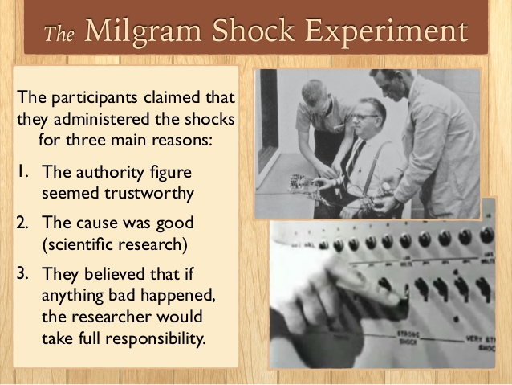
If the teacher still wanted to stop after these four sayings were used they were allowed to do so. However, if they continued, the shocks that were then given were 3 deadly 450 volt shocks.
This allowed the scientists to come to a rather unnerving conclusion.
It showed just how susceptible human beings are to an authority figure.

Slide 24
Conclusion
Ordinary people are likely to follow orders given by an authority figure, even to the extent of killing an innocent human being. Obedience to authority is ingrained in us all from the way we are brought up.
People tend to obey orders from other people if they recognize their authority as morally right and/or legally based. This response to legitimate authority is learned in a variety of situations, for example in the family, school, and workplace.

Slide 25
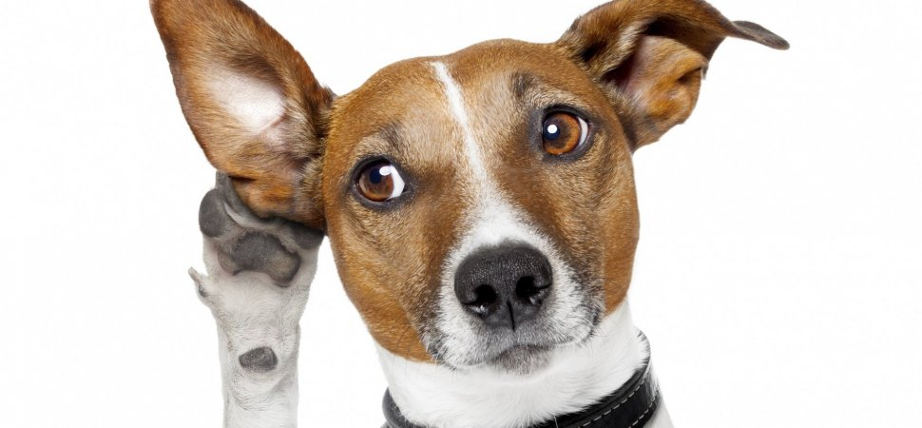
Fake TV game show…
Listen to the audio and answer the questions.

Slide 26
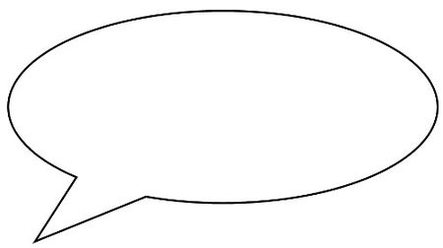
Oral Interaction
The Milgram Experiment Interaction orale :
2 scientifiques v. 2 membres d’un comité d’éthique.
Un scientifique et un producteur TV doivent faire accepter par le comité d’éthique l’organisation du TV Game Show reproduisant l’expérience de Milgram.
Organise yourselves into a group of four: 2 people will be the producer and the scientist trying to get this experiment put onto television.
2 people will be members of the broadcasting company’s ethics committee and are completely against the idea. You must debate each sides reasons as to why you are FOR or AGAINST this idea.

